Slide 1
Introduction to Mixtures

Slide 2
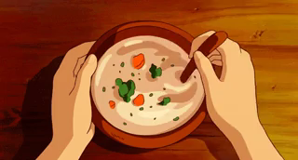
At the end of this lesson, you should be able to:
Explain what a mixture is.
Explain what a pure substance is.

Slide 3
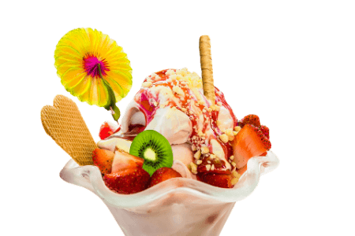
When you make an ice cream sundae, you make it from lots of different objects.
You add ice cream, sauce, sprinkles, fruit, or whatever else you want to make it delicious!
Many objects in our world are made up of smaller objects, just like a sundae. In science, we say that when an object is made up of smaller objects, it is called a mixture.

Slide 4
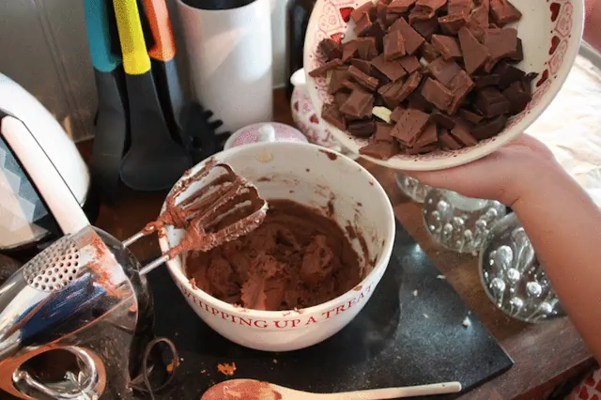
A mixture is made from two or more substances that have been combined together.

Slide 5
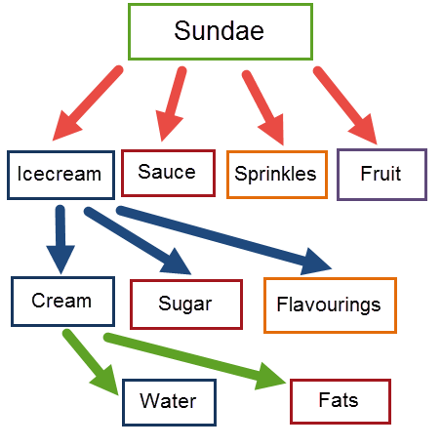
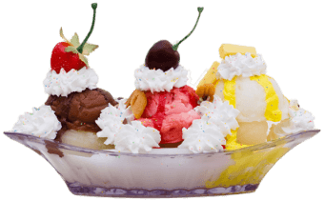
Most of the parts of a sundae are also mixtures.
For example, an ice cream sundae is made from ice cream, chocolate sauce, sprinkles, fruit and maybe even more!
Cream is, itself, a mixture of water and fats, and this layering of mixtures can just keep going and going!

Slide 6
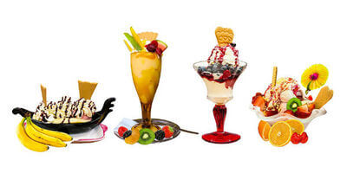
Water and sugar don't reduce to anything different; they don't have anything else in them.
We call things like this "pure substances".
Mixtures, like the ice cream sundae, are made from lots of different things and are "impure substances".

Slide 7
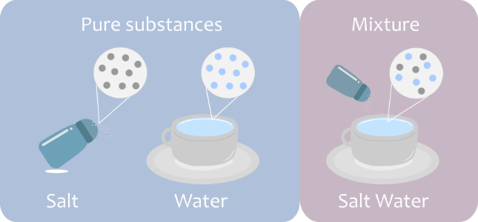
All substances are made up of tiny units called "particles".
They are far too small to see, with one grain of sugar containing millions and millions of particles! There are very many types of particles.
A pure substance is made from just one type of particle.
Mixtures are made up of different types of particles.

Slide 8
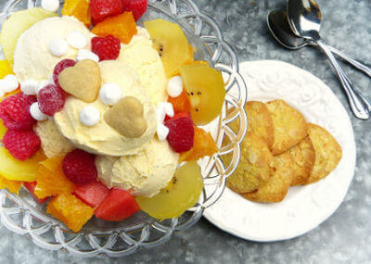
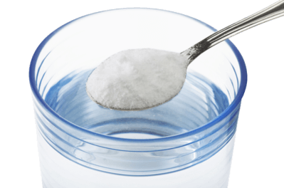
Water is a pure substance because it contains only water particles.
Salt is also a pure substance because it is made up of salt particles.
Meanwhile, sundaes contain many different types of particles, so they are a mixture and impure.

